Slide 1
CS 540 Network Architecture
Lecture 5: Inter AS Routing
Prof. Younghee Lee

Slide 2
BGP problem
Table growth
Multihoming, load balancing, address fragmentation, and failure to aggregate address prefixes
Convergence
BGP may explore many routes before finding the right new one
Correctness
Routes may not be valid, visible, or loop-free
Instability: route flapping due to high routing update
Multiprotocol extension: IPv4, IPv6…
Security
Hard to check veracity of information (e.g., AS path)
Can’t tell where data traffic is actually going to go
Complex policy control: broken business model
Universal connectivity depends on cooperation: No guarantees
BGP: simple protocol but extremely complex configuration flexibility

Slide 3
Internet Routing Instability [Labovitz et al ’96]
Problems caused by routing instability
Increased delays, packet loss and reordering, time for routes to converge (small-scale route changes)
Types of Inter-domain Routing Updates
Forwarding instability: may reflect topology changes
Policy fluctuations (Routing instability): may reflect changes in routing policy information
Pathological updates: redundant updates that are neither routing nor forwarding instability
Instability: forwarding instability and policy fluctuation change forwarding path

Slide 4
BGP Information Exchange
Announcements: a router has either
Learned of a new route, or
Made a policy decision that it prefers a new route
Withdrawals: a router concludes that a network is no longer reachable
Explicit: associated to the withdrawal message
Implicit: when a route is replaced as a result of an announcement message
In steady state BGP updates should be the result only of infrequent policy changes
Update rate ➔ measure of network stability

Slide 5
Routing Successive Events (Instability)
WADiff: a route is explicitly withdrawn as it becomes unreachable, and is later replaced with an alternative route (forwarding instability)
AADiff: a route is implicitly withdrawn and replaced by an alternative route as the original route becomes unavailable or a new preferred route becomes available (forwarding instability)
WADup: a route is explicitly withdrawn, and reannounced later (forwarding instability or pathological behavior)

Slide 6
Routing Successive Events (Pathological Instability)
AADup: A route is implicitly withdrawn and replaced with a duplicate of the original route (pathological behavior or policy fluctuation)
WWDup: The repeated transmission of BGP withdrawals for a prefix that is currently unreachable (pathological behavior)

Slide 7
Findings
BGP updates more than one order of magnitude larger than expected
Routing information dominated by pathological updates
Implementation problems:
Routers do not maintain the history of the announcements sent to neighbors
When a router gets topological changes they just sent these announcements to all neighbors, irrespective of whether the router sent previous announcements about that route to a neighbor or not
Self-synchronization – BGP routers exchange information simultaneously → may lead to link periodic link/router failures
Unconstrained routing policies may lead to persistent route oscillations

Slide 8
Findings
Instability and redundant updates exhibits strong correlation with load (30 seconds, 24 hours and seven days periods)
Overloaded routers fail to respond an their neighbors withdrawn them
Instability usually exhibits high frequency
Pathological updates exhibits both high and low frequencies
No single AS dominates instability statistics
No correlation between size of AS and its impact on instability statistics
There is no small set of paths that dominate instability statistics

Slide 9
BGP misconfiguration [Mahajan02]
How common are misconfigurations?
Their impact on connectivity and routing load?
Defined as behavior unintended by the operator
Includes both slips (inadvertent errors) and mistakes (erroneous plan)
Two broad classes of globally visible faults
Origin misconfiguration
Export misconfiguration

Slide 10
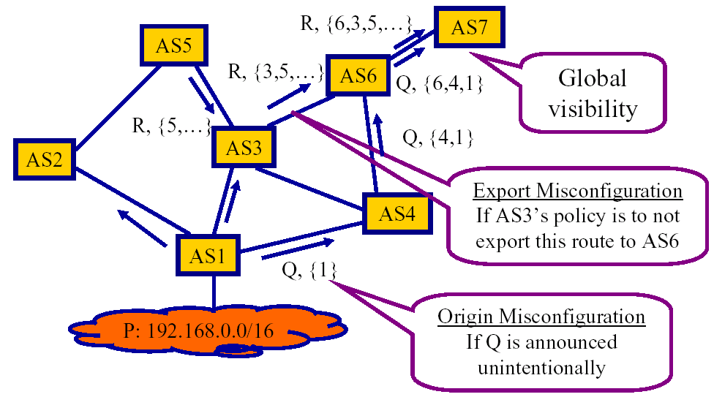
BGP misconfiguration [Mahajan02]

Slide 11
BGP misconfiguration [Mahajan02]
Conclusions
Misconfigurations are commonplace
Connectivity is surprisingly robust to most misconfigs but routing load can be significant
The causes of misconfigurations are diverse
Much needs to be done to improve the operational reliability of the Internet

Slide 12
Lessons: Routing
Even after decades of experience routing in the Internet is not a solved problem
This attests the difficulty and complexity of building distributed algorithm in the Internet, i.e., in a heterogeneous environment with products from various vendors
Simple protocols may increase the chance to be
Understood
Implemented right
Ip, bgp protocols are supposed to be simple protocol

Slide 13
Modeling the Process: IP address
IETF
IANA
Regional Internet Registries (RIRs)
RIR
Delegation
ISP
Allocation
IANA
Allocation
RIR
Announcement
Internet Assigned Numbers Authority
ISP
Allocation of /8 blocks
to RIRs and others
BGP routing table
BGP
Allocation of blocks to LIRs
Local Internet registry (LIR) or National Internet Registry (NIR)
Source: Report of Asia Pacific Network Information Center (APNIC), Paul Wilson, “IPv4 Address Lifetime”,

Slide 14
IANA Allocations - Projection
Prediction at 1990’: IPv4 addresses would be exhausted around 2008-2011
IANA Prediction at 2004: IPv4 addresses would be exhausted around 2020
APNIC Prediction at 2004: IPv4 addresses would be exhausted around 2027
Source: Report of Asia Pacific Network Information Center (APNIC), Paul Wilson, “IPv4 Address Lifetime” 2004

Slide 15
BGP Announcements - Projection
Projected date of address pool exhaustion according to BGP: 2027
Source: Report of Asia Pacific Network Information Center (APNIC), Paul Wilson, “IPv4 Address Lifetime” 2004

Slide 16
BGP Routing Table Growth
The most obvious noise comes from flaps in /8 (Class A IP Address ) advertisements.
The first step was to remove this noise by recalculating the address data using a fixed number of /8 advertisements
Reduce number of prefixes
Cannot discard or delete state
… because you won’t receive the message again
Assuming exponential growth
Address space lasts until 2025, or up to 2029
Assuming linear growth
Address space lasts until 2037 - 2047
Source: Report of Asia Pacific Network Information Center (APNIC), Paul Wilson, “IPv4 Address Lifetime” 2004

Slide 17
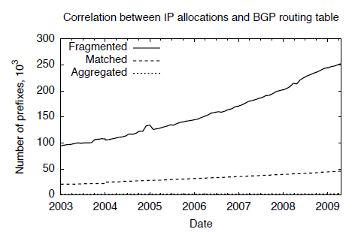
BGP Routing Table Growth
Classless Interdomain Routing (CIDR)
Reduce number of prefixes
150,000 ~ 200,000 prefixes per RT as of 2005
Long delay to lookup
Table overflow
Some part of this teaching materials are prepared referencing the lecture note made by Jennifer Rexford, Princeton university

Slide 18
BGP overload
Network Destination | Netmask | Gateway | Interface | Metric
0.0.0.0 | 0.0.0.0 | 192.168.0.1 | 192.168.0.100 | 10
127.0.0.0 | 255.0.0.0 | 127.0.0.1 | 127.0.0.1 | 1
192.168.0.0 | 255.255.255.0 | 192.168.0.100 | 192.168.0.100 | 10
192.168.0.100 | 255.255.255.255 | 127.0.0.1 | 127.0.0.1 | 10
192.168.0.255 | 255.255.255.255 | 192.168.0.100 | 192.168.0.100 | 10
Incremental protocol
New route => announcement
Withdrawal when the route is no longer available
But no messages when nothing is changing or when RT overflow
Cannot discard or delete state easily
because you won’t receive the message again
Overload => all BGP session => reboot => heavy BGP load on neighbors
More prefix => more update messages => overhead, delay
BGP route flapping => unstable routing system
RIB: routing table
FIB: Smaller forwarding table for packet forwarding
forwarding table contains only the routes which are chosen by the routing algorithm
Often compressed to optimize for hardware storage and lookup

Slide 19
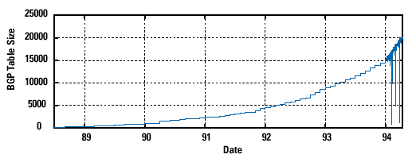
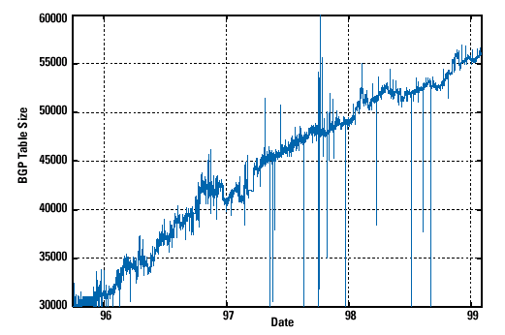
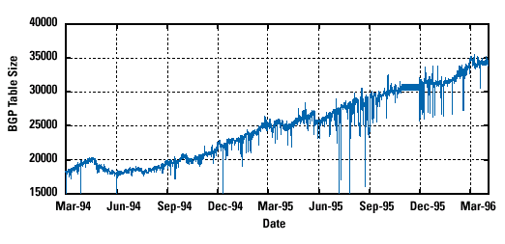
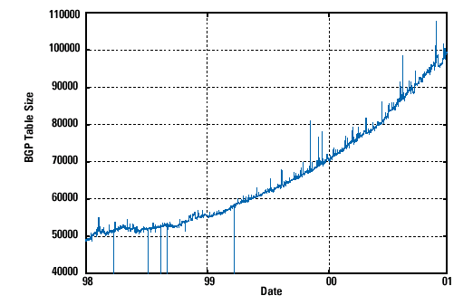
CIDR
With CIDR: flatter or linear growth
Pre-CIDR: exponential growth
Steep growth: due to Internet boom and multi-homing
With CIDR: flatter or linear growth (IETF)

Slide 20
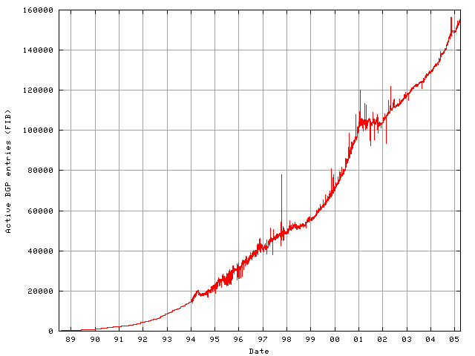
BGP entries
Post-boom

Slide 21
BGP Growth: Multi homing
Multi-homing is the process of selecting, provisioning, and installing a redundant connection to the Internet.
Could be the same provider, or a different provider.
Slow is much better than dead.
Telco circuits die., Routers die., Providers’ networks fail.
Different networks have better performance to different sites.
All providers must advertise the prefix
Hole-punching: subnet contained in a supernet
Detecting hole-punching
Prefix is contained in one provider’s supernet
12.0.0.0/8
12.0.0.0/8
12.1.1.0/24
ISP #1
ISP #2
12.0.0.0/8
12.1.1.0/24
3.0.0.0/8
12.1.1.0/24
the most specific route wins
12.1.1.0/24
Stub
Some part of this teaching materials are prepared referencing the lecture note made by Jennifer Rexford, Princeton university
12.1.1.0/24

Slide 22
BGP Growth: load balancing
Same address block is covered by several announced prefixes
Advertise multiple subnets of a larger prefix
Treat differently to influence incoming traffic
Detecting load balancing
Prefixes originated by the same AS
Could be collapsed(e.g., contiguous or contained but different attribute such as AS path)
ISP #1
ISP #2
12.1.2.0/23
12.1.2.0/24
12.1.2.0/23
12.1.3.0/24
Stub
Some part of this teaching materials are prepared referencing the lecture note made by Jennifer Rexford, Princeton university

Slide 23
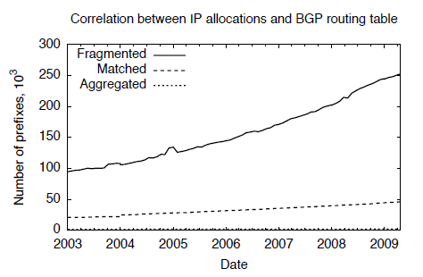
BGP Growth: Fragmentation
Different part of the address space
Distinct address blocks allocated to same AS
Advertised separately in BGP
For various possible reasons (e.g., geographical dispersion), ISPs split up allocated blocks into a number of sub-blocks and announce each of these independently.
ISP #1
18.8.0.0/16
12.1.1.0/24
Stub

Slide 24
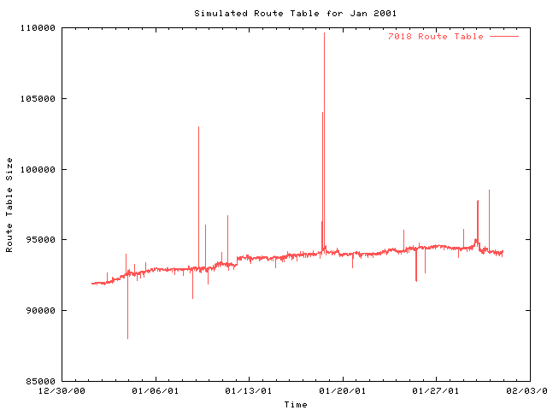
BGP Growth: Four Causes
Address fragmentation:
Most significant
Multi-homing
Increasing over time
Load balancing
Increasing over time
Failure to aggregation
Least significant
approximately 15 to 20% prefixes could be aggregated beyond what network operators have done
* Transient spike due to neighbor’s BGP mistake

Slide 25
BGP Growth: How to limit growth
Hierarchical address allocation
Allocate smaller blocks to customers
Reclaim address blocks when customers leave
Hierarchical address allocation inside the ISP
Filtering Small Subnets on BGP Sessions
Larger mask than RIR guidelines
e.g., filter /20 and longer in 63.0.0.0/8
Or, all prefixes with mask longer than /24
Aggressive filtering?: risk of disconnecting some part of the Internet or thwarting load-balancing of stub ASes
Careful scoping of BGP route advertisements
Explicit minimization of FIB and RIB sizes
RIB: Routing Information Base
holds all routing information received from routing peers
FIB: Forwarding Information Base
minimum amount of information necessary to make a forwarding decision on a particular packet

Slide 26
Reading Assignment
Nick McKeown, “Fast Switched Backplane for a Gigabit Switched Router”
Guido Appenzeller et al., “Sizing Router Buffers”
Submit 1 page report online via KLMS by 6pm Sep. 26 which is the day before the lecture of Sep. 27 (Tue.)
Submit also 1 page report (hard copy) at the beginning of the lecture of Sep. 27 (Tue.) as attendance check and for discussion

Slide 27
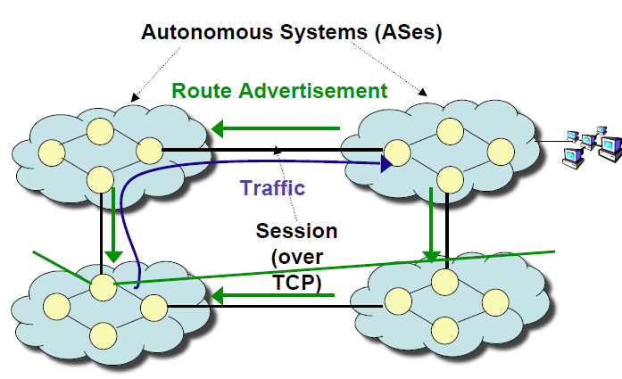
BGP
Path-vector
Record what ASes a route went through to reach the destination
Distance vector does not give you information of the path that you will take
Complex path selection process: path length of 2 can take more time than path length of 4 because of the inside topology of the ASes.
Distance vector?
Some part of this teaching materials are prepared referencing the lecture note made by Hari Balakrishnan

Slide 28
Path-Vector Protocols: BGP and IDRP
Path-vector routing
drawback of distance-vector protocol for an exterior routing protocol
If different routers attach different meanings to a given metric, it may not be possible to create stable, loop free-routes
no information about AS. A AS may have different priorities from other AS.
drawback of link-state routing protocol for an exterior routing protocol
Different ASs may use different metrics and have different restrictions. Impossible to perform a consistent routing algorithm
flooding across multiple ASs may be unmanageable
provide information about which networks can be reached by a given router and the ASs that must be crossed there.
Distance vector approach does not include a distance or cost estimate
Each block of routing information lists all of the ASs visited to reach the destination network by this route.
Policy routing

Slide 29
BGP-4: Border Gateway Protocol
Assumes the Internet is an arbitrarily interconnected set of AS's.
local traffic: traffic that originates at or terminates on nodes within an AS
transit traffic: traffic that passes through an AS
Three types of AS’s:
Stub AS: an AS that has only a single connection to one other AS : only local traffic
Multihomed AS: an AS that has connections to more than one other AS, but refuses to carry transit traffic.
Transit AS: an AS that has connections to more than one other AS, and is designed to carry both transit and local traffic.
Each AS has:
One or more border routers
One BGP speaker that advertises:
local networks
other reachable networks (transit AS only)
gives path information

Slide 30
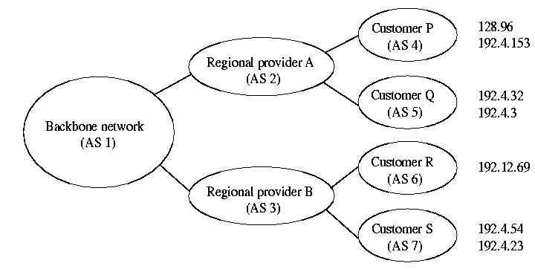
BGP Example
Speaker for AS 2 advertises reachability to P and Q
Network 128.96, 192.4.153, 192.4.32, and 192.4.3, can be
reached directly from AS 2.
Speaker for backbone network then advertises
Networks 128.96, 192.4.153, 192.4.32, and 192.4.3 can be
reached along the path <AS 1, AS 2>.
Speaker can also cancel previously advertised paths

Slide 31
Internet inter-AS routing: BGP
Suppose: gateway X send its path to peer gateway W
W may or may not select path offered by X
cost, policy (don’t route via competitors AS), loop prevention reasons.
If W selects path advertised by X, then:
Path (W,Z) = w, Path (X,Z)
Note: X can control incoming traffic by controlling it route advertisements to peers:
e.g., don’t want to route traffic to Z -> don’t advertise any routes to Z
BGP does not mandate a policy for selecting paths

Slide 32
Internet inter-AS routing: BGP
BGP messages exchanged using TCP.
BGP messages:
OPEN: opens TCP connection to peer and authenticates sender
UPDATE: advertises new path (or withdraws old)
KEEPALIVE keeps connection alive in absence of UPDATES; also ACKs OPEN request
NOTIFICATION: reports errors in previous msg; also used to close connection

Slide 33
Why different Intra- and Inter-AS routing ?
Policy:
Inter-AS: admin wants control over how its traffic routed, who routes through its net.
Intra-AS: single admin, so no policy decisions needed
Scale:
hierarchical routing saves table size, reduced update traffic
Performance:
Intra-AS: can focus on performance
Inter-AS: policy may dominate over performance
Problem?

Slide 34
eBGP, iBGP
External BGP (eBGP): exchanging routes between ASes
Internal BGP (iBGP): disseminating routes to external destinations among the routers within an AS
Most ASes have more than one “border” router that talks to other peer
Must be loop-free, best and consistent route from each eBGP router in the AS
iBGP
eBGP

Slide 35
Routing attribute & Route Selection
Local preference
Numerical value assigned by routing policy: primary, backup…
AS path length
Shortest AS path != shortest path
AS path length hack: prepending
Shortest IGP path cost to next hop
Hot-Potato Routing: large traffic shift?
Higher local pref
Primary
AS 4
AS Path: “2 1”
AS Path: “3 1 1”
Destination
Traffic
AS 2
AS 3
Backup
Lower local pref
AS Path: “1”
AS Path: “1 1”
AS 1
D
Dest.
New York
Atlanta
Traffic
11
5
10
I
Interior Gateway Protocol (IGP): for exchanging routing information between gateways within an AS: OSPF, RIP..
Washington, DC

Slide 36
IDRP(Inter-Domain Routing Protocol)
Designed for IPv6
ISO standard, a superset of BGP’s functions
Key differences
BGP operates over TCP, whereas IDRP operates over the IP used in the configuration. IDRP include its own handshaking exchange to guarantee delivery of messages: for better performance
BGP uses 16-bit autonomous system number. IDRP uses variable-length identifiers.
IDRP can deal with multiple internet protocols and multiple internet address scheme.
BGP communicates a path by specifying the complete list of ASs that a path visit. IDRP is able to aggregate this information using the concept of routing domain confederation(group of ASs appear to the outside world as single AS)

Slide 37
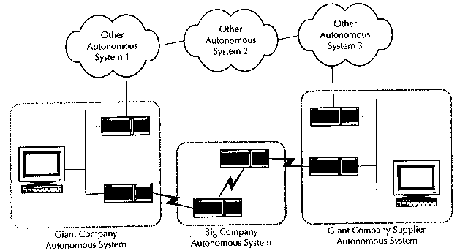
Policy
Goal of OSPF: figure out the best way to get from here to there
Goal of IDR: figure out the best way to get from here to there without passing through a restricted area(defines policies)

Slide 38
Implementing Policy
Policies constrain communications: 3 different ways to implement policy
Implementing policy with bandwidth
Implementing policy with packet filter
Implementing policy by restricting routing information

Slide 39
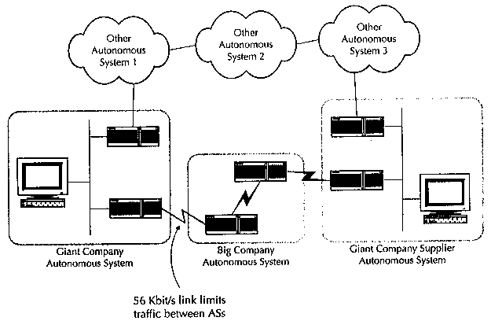
Implementing Policy
Implementing policy with bandwidth
allowing only limited bandwidth (0 to N bps)

Slide 40
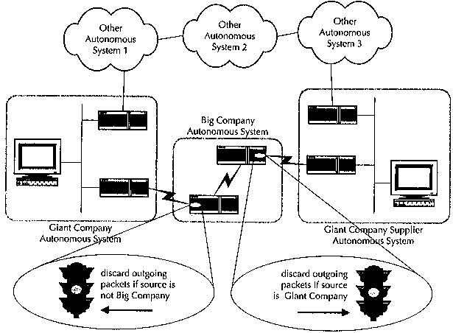
Implementing Policy
Implementing policy with packet filter
constrains in the forwarding process
most commercial routers support
substantial computation burden on the router
administering packet filters is a challenge: need in-depth knowledge of message formats and possible values for various fields within packets

Slide 41
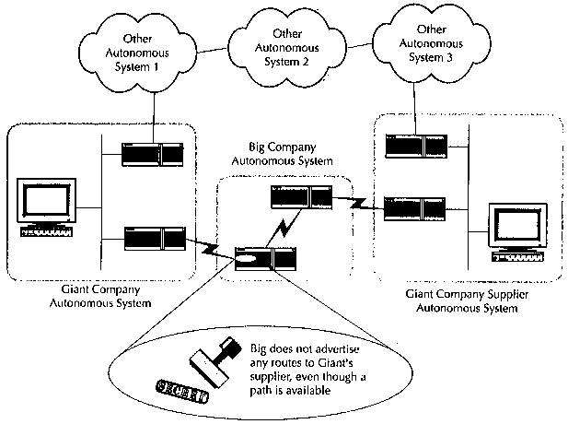
Implementing Policy
Implementing policy by restricting routing information
policy based routing: IDRP relies on this method
places constraints on how routers distribute routing information
not require special calculations for every IP datagram

